Slide 1
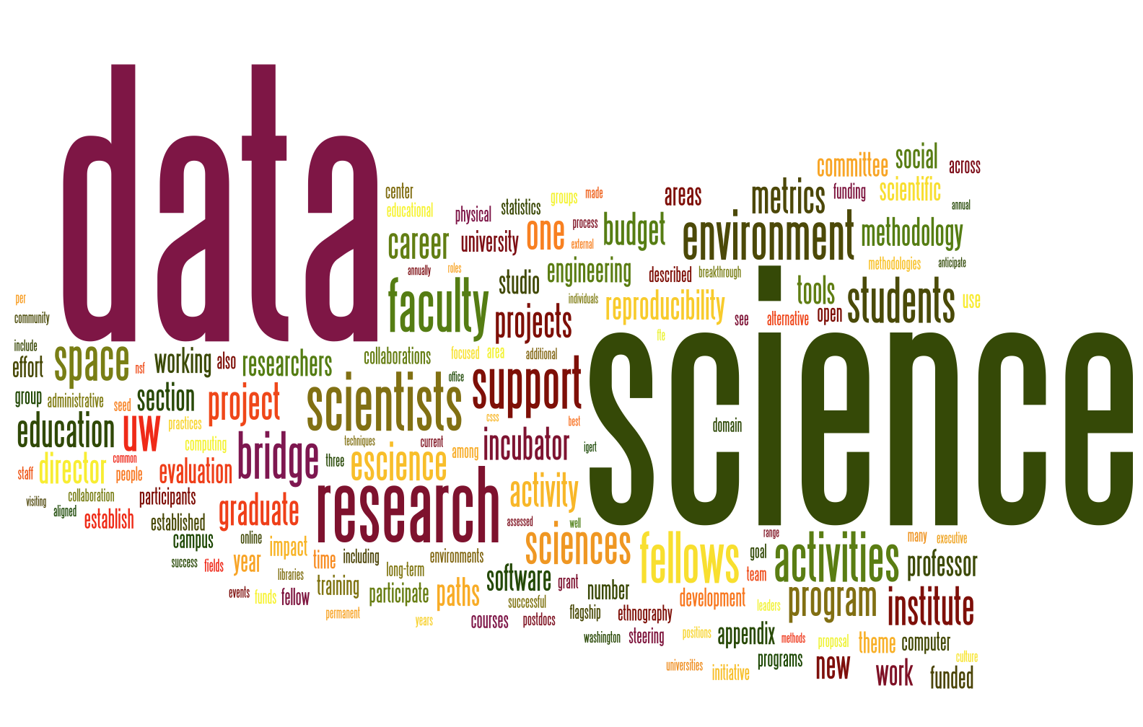
What is Data Science
http://www.bigdatatraining.in/data-science-training-chennai/
Oleksii Yehorchenkov
Taras Shevchenko National University of Kyiv
License
These materials are available under the Creative Commons Attribution NonCommercial ShareAlike (CC-NC-SA) license
https://creativecommons.org/licenses/by-nc-sa/3.0/

Slide 2
What is Data Science?
Data science, also known as data-driven science, is an interdisciplinary field about scientific methods, processes and systems to extract knowledge (знання) or insights (розуміння) from data in various forms, either structured or unstructured
https://en.wikipedia.org/wiki/Data_science

Slide 3
What is Data Science?
Data science is a "concept to unify statistics, data analysis and their related methods" in order to "understand and analyze actual phenomena" with data. It employs techniques and theories drawn from many fields within the broad areas of mathematics, statistics, information science, and computer science, in particular from the subdomains of machine learning, classification, cluster analysis, data mining, databases, and visualization.
https://en.wikipedia.org/wiki/Data_science

Slide 4
Who is a Data Scientist?
Data scientists use their data and analytical ability to find and interpret rich data sources; manage large amounts of data despite (в умовах) hardware, software, and bandwidth (полоса пропускання) constraints (обмеження); merge data sources; ensure consistency of datasets (забезпечувати узгодженість наборів даних); create visualizations to aid in understanding data; build mathematical models using the data; and present and communicate the data insights/findings. They are often expected to produce answers in days rather than months, work by exploratory analysis and rapid iteration, and to produce and present results with dashboards (displays of current values) rather than papers/reports, as statisticians normally do.
https://en.wikipedia.org/wiki/Data_science

Slide 5
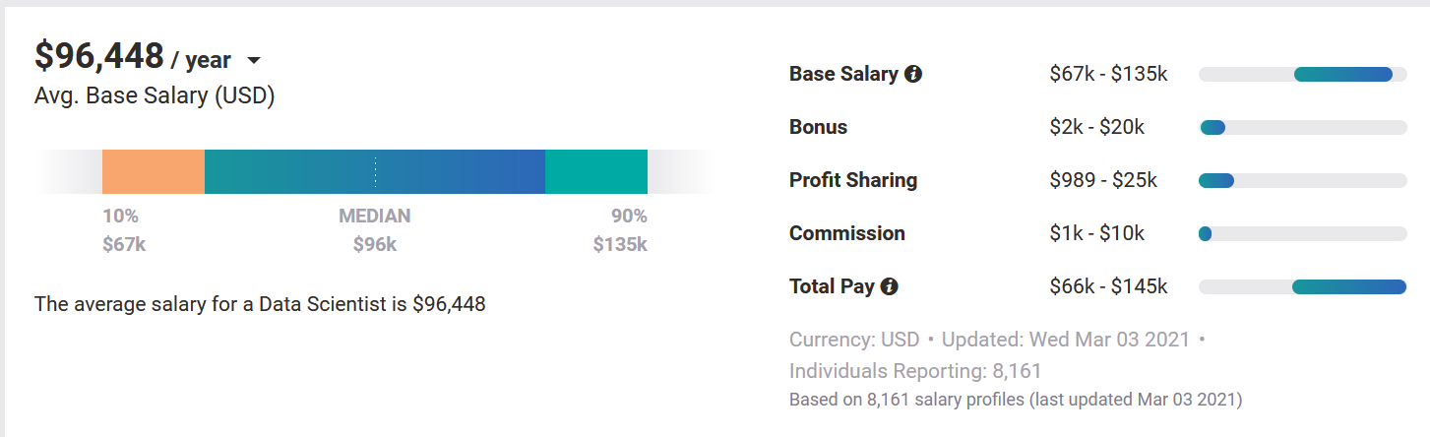
Motivation
https://www.payscale.com/research/US/Job=Data_Scientist/Salary

Slide 6
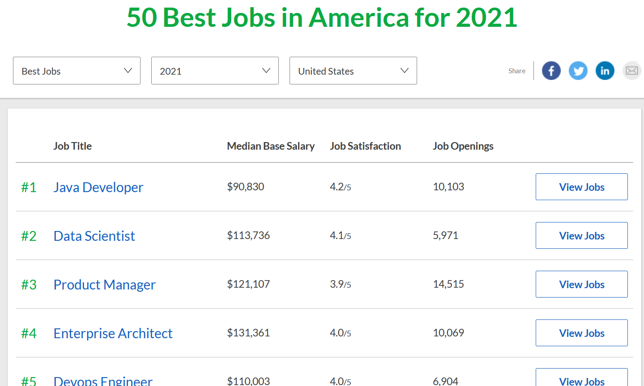
Best jobs
https://www.glassdoor.com/List/Best-Jobs-in-America-LST_KQ0,20.htm

Slide 7
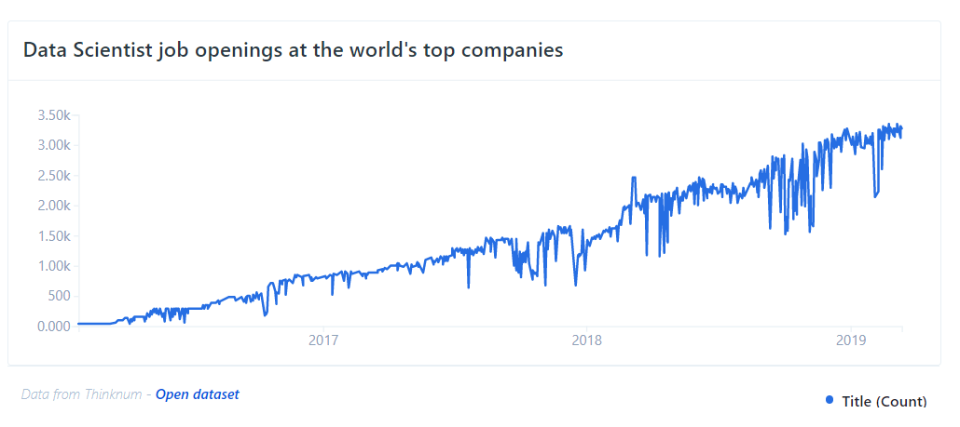
Job growth
https://www.tecla.io/blog/the-high-demand-for-data-scientists-and-how-to-hire-for-them/

Slide 8
This course
Introducing you to the track
Getting tools set up
Giving you basic background
Giving you basic skills in Python language

Slide 9
References
Course materials for the Data Science Specialization: https://www.coursera.org/specialization/jhudatascience/1 https://github.com/DataScienceSpecialization/courses

